Slide 1
Platformer
Jack Feinberg

Slide 2
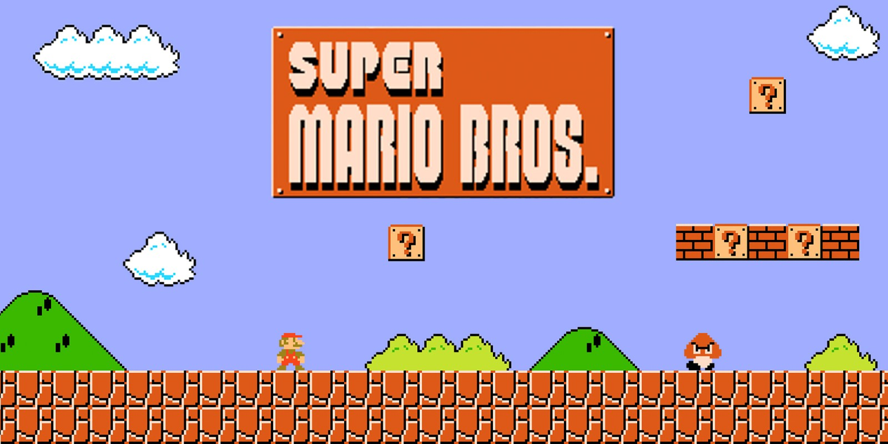
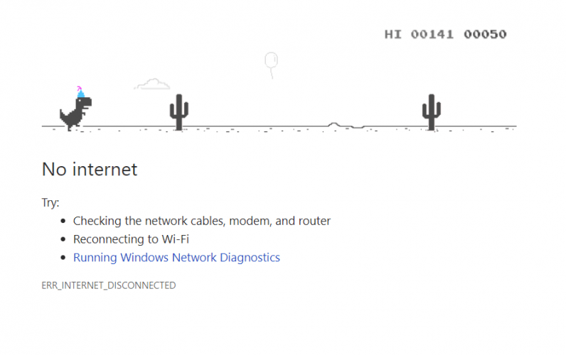

Slide 3
Retro style
Go on forever
High score leaderboard
Attack function
Would be cool to have a choose your character option

